Slide 1
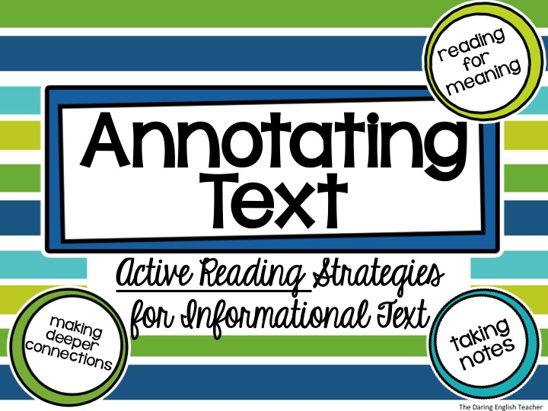

Slide 2

Raise your hand if…
you have ever read an entire paragraph, passage, or page only to realize that you have absolutely no clue what you just read.

Slide 3
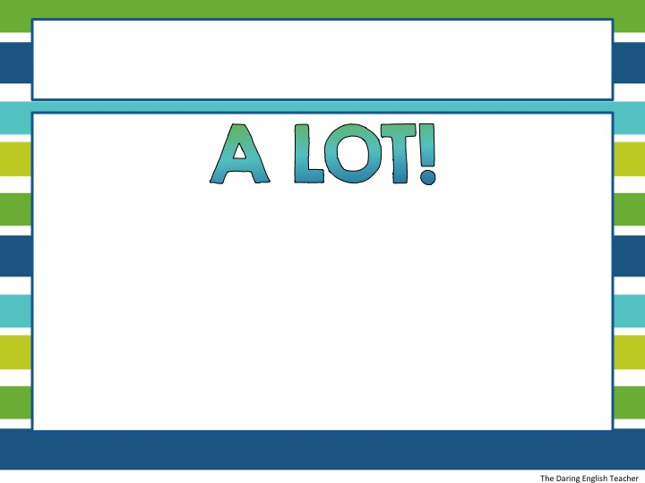
It happens…
STOP WASTING TIME WITH MINDLESS READING!
Annotating a text will help you not only remember what you read, but understand and connect with the text.

Slide 4

What is Annotating?
Annotation is the ACT of making a note in ANY form while reading

Slide 5
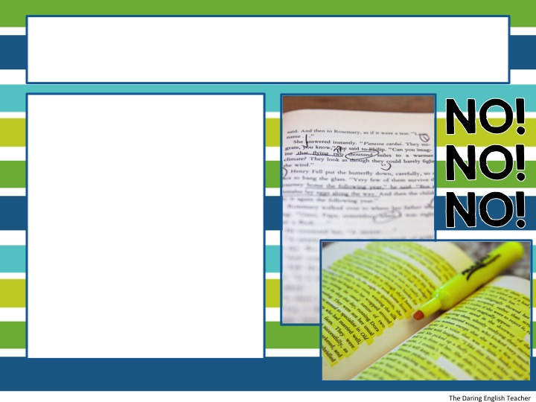
Annotation is NOT…
Highlighting without a purpose
Underlining or highlighting the majority of the text
Drawing symbols without writing notes

Slide 6

Why Do We Annotate?
The majority of reading is just skimming, this is NOT helpful when reading for understanding.
Annotating a Text:
slows the reader down
promotes active reading
improves reading and writing
allows the reader to make deeper connections

Slide 7

What Will I Need?
Annotation tools:
Pencil
Colored pens (optional)
Highlighter (optional)
Post-it notes (optional)
Annotation Guide
Your own copy of the text!

Slide 8
Annotation Guide
Symbol | Guide
circle | Powerful words and phrases
underline | Words or phrases you do not understand. Try to use context clues in the text to help you write a definition in the margins
? | Place a question mark next to text that raises questions
! | Place an exclamation point next to ideas that surprise you
 | Draw arrows when you make a connection to the text, ideas, or experiences
EX | Write “EX” next to the author’s examples
1, 2, 3 | Number the author’s arguments, key details, and important ideas
WRITE | Write important thoughts and connection in the margins
WRITE | Write questions you have about the reading in the margins

Slide 9
Annotation Guide
Symbol | Guide
circle | Powerful words and phrases (WRITE AND EXPLAIN WHY THEY ARE POWERFUL)
underline | Words or phrases you do not understand. Try to use context clues in the text to help you write a definition in the margins (GO BACK AND DEFINE THE WORDS)
? | Place a question mark next to text that raises questions (EXPLAIN WHY IT MADE YOU QUESTION THE TEXT. WRITE ANY CONNECTIONS OR INFERENCES YOU MAKE)
! | Place an exclamation point next to ideas that surprise you (EXPLAIN WHY IT SUPRSED YOU)
 | Draw arrows when you make a connection to the text, ideas, or experiences (WRITE THE CONNECTIONS DOWN. EXPLAIN WHAT IT MEANS)
EX | Write “EX” next to the author’s examples (EXPLAIN THE EXAMPLE AND HOW IT HELPS THE AUTHOR PROVIE HIS/HER ARGUMENT)
1, 2, 3 | Number the author’s arguments, key details, and important ideas (EXPLAIN THE ARGUMENTS. IDENTIFY WHICH ARGUMENT/DETAIL IS THE STRONGEST)
WRITE | Write important thoughts and connection in the margins
WRITE | Write questions you have about the reading in the margins

Slide 10

Steps to Annotate Text
1. Preview the text (look ahead, briefly skim, read headlines, sub headlines, and picture captions, and look at pictures).

Slide 11

Steps to Annotate Text
2. Read a brief portion of the text. Depending on the length, a couple paragraphs is a good starting place.

Slide 12
Steps to Annotate Text
3. Go back over the text you just read, and use the annotation guide to help you make notes on the text.

Slide 13
Steps to Annotate Text
4. Check and see if your annotations make sense. Are you adding new text to the margins or just rewriting it? Use your own words as much as possible. Make sure you write notes to accompany your symbols.

Slide 14

Steps to Annotate Text
5. Repeat steps 2-4. Read another small chunk of text and annotate it. Then, make sure that all of the annotated marks make sense.

Slide 15
Practice
The Gettysburg Address
By: President Abraham Lincoln
Use the symbols from the previous slide to annotate President Abraham Lincoln’s famous, “Gettysburg Address.”
Four score and seven years ago our fathers brought forth on this continent, a new nation, conceived in Liberty, and dedicated to the proposition that all men are created equal.
Now we are engaged in a great civil war, testing whether that nation, or any nation so conceived and dedicated, can long endure. We are met on a great battle-field of that war. We have come to dedicate a portion of that field, as a final resting place for those who here gave their lives that that nation might live. It is altogether fitting and proper that we should do this.

Slide 16
Practice
The Gettysburg Address
By: President Abraham Lincoln
Step 1: Preview the Text
Four score and seven years ago our fathers brought forth on this continent, a new nation, conceived in Liberty, and dedicated to the proposition that all men are created equal.
Now we are engaged in a great civil war, testing whether that nation, or any nation so conceived and dedicated, can long endure. We are met on a great battle-field of that war. We have come to dedicate a portion of that field, as a final resting place for those who here gave their lives that that nation might live. It is altogether fitting and proper that we should do this.

Slide 17
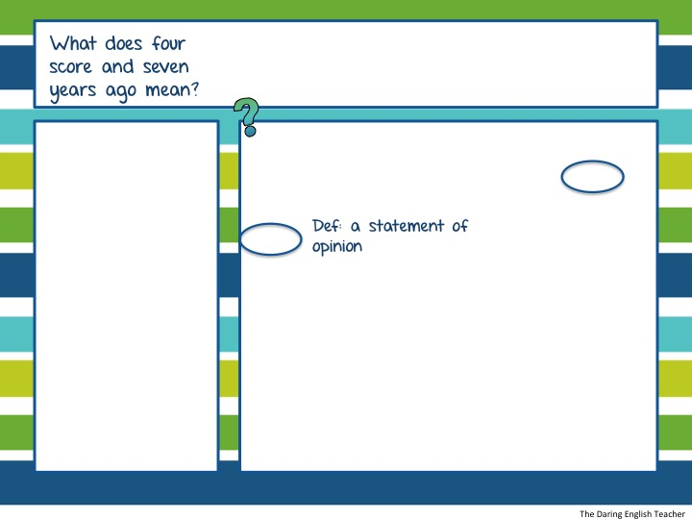
Practice
The Gettysburg Address
By: President Abraham Lincoln
Step 2-3 : Read a brief portion of the text and annotate.
Four score and seven years ago our fathers brought forth on this continent, a new nation, conceived in Liberty, and dedicated to the proposition that all men are created equal.

Slide 18
Practice
The Gettysburg Address
By: President Abraham Lincoln
Step 4: Check to see if your annotations make sense.
Four score and seven years ago our fathers brought forth on this continent, a new nation, conceived in Liberty, and dedicated to the proposition that all men are created equal.

Slide 19
Practice
The Gettysburg Address
By: President Abraham Lincoln
Step 4: Check to see if your annotations make sense.
Four score and seven years ago our fathers brought forth on this continent, a new nation, conceived in Liberty, and dedicated to the proposition that all men are created equal.

Slide 20
Practice
The Gettysburg Address
By: President Abraham Lincoln
Step 5: Repeat steps 2-4. Read and annotate more.
Four score and seven years ago our fathers brought forth on this continent, a new nation, conceived in Liberty, and dedicated to the proposition that all men are created equal.
Now we are engaged in a great civil war, testing whether that nation, or any nation so conceived and dedicated, can long endure. We are met on a great battle-field of that war. We have come to dedicate a portion of that field, as a final resting place for those who here gave their lives that that nation might live. It is altogether fitting and proper that we should do this.

Slide 21
Practice
The Gettysburg Address
By: President Abraham Lincoln
Use the symbols from the previous slide to annotate President Abraham Lincoln’s famous, “Gettysburg Address.”
Four score and seven years ago our fathers brought forth on this continent, a new nation, conceived in Liberty, and dedicated to the proposition that all men are created equal.
Now we are engaged in a great civil war, testing whether that nation, or any nation so conceived and dedicated, can long endure. We are met on a great battle-field of that war. We have come to dedicate a portion of that field, as a final resting place for those who here gave their lives that that nation might live. It is altogether fitting and proper that we should do this.
repetition
time period
Purpose of text
?
Do what?

Slide 22
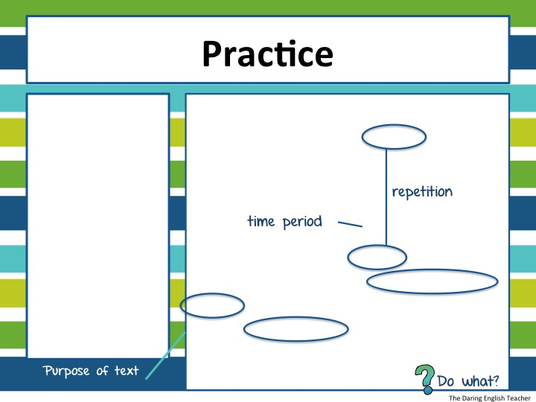
Practice
The Gettysburg Address
By: President Abraham Lincoln
Use the symbols from the previous slide to annotate President Abraham Lincoln’s famous, “Gettysburg Address.”
Four score and seven years ago our fathers brought forth on this continent, a new nation, conceived in Liberty, and dedicated to the proposition that all men are created equal.
Now we are engaged in a great civil war, testing whether that nation, or any nation so conceived and dedicated, can long endure. We are met on a great battle-field of that war. We have come to dedicate a portion of that field, as a final resting place for those who here gave their lives that that nation might live. It is altogether fitting and proper that we should do this.

Slide 23
The Gettysburg Address
Four score and seven years ago our fathers brought forth on this continent, a new nation, conceived in Liberty, and dedicated to the proposition that all men are created equal.
Now we are engaged in a great civil war, testing whether that nation, or any nation so conceived and dedicated, can long endure. We are met on a great battle-field of that war. We have come to dedicate a portion of that field, as a final resting place for those who here gave their lives that that nation might live. It is altogether fitting and proper that we should do this.
But, in a larger sense, we can not dedicate -- we can not consecrate -- we can not hallow -- this ground. The brave men, living and dead, who struggled here, have consecrated it, far above our poor power to add or detract. The world will little note, nor long remember what we say here, but it can never forget what they did here. It is for us the living, rather, to be dedicated here to the unfinished work which they who fought here have thus far so nobly advanced. It is rather for us to be here dedicated to the great task remaining before us -- that from these honored dead we take increased devotion to that cause for which they gave the last full measure of devotion -- that we here highly resolve that these dead shall not have died in vain -- that this nation, under God, shall have a new birth of freedom -- and that government of the people, by the people, for the people, shall not perish from the earth.

